Slide 1
University Institute Of Technology Rajiv Gandhi Proudyogiki Vishwavidyalaya Bhopal Session: 2022-23
Project:- “Query_Solver” Platform For Student
Submitted To:- Submitted By:-
Dharmendra Patel
Manisha Patidar
Sakshi Gautam
Atul Panday
Department of
MCA

Slide 2
Content
Objective
Modules in Project
Software specification
Introduction
Working
Implementation
Conclusion and future work
Data Flow Diagram
Use Case Diagram
ER Diagram
Snapshots
Technologies Used

Slide 3
Motivation & Objective
Ever wondered if you could solve your doubts at one place anywhere, anytime? One thing I struggled most through my college years was solving my doubt at the right time. Because many times while we are in the class we don’t have doubts but when we have doubts there is nobody to solve it.
That’s why I decide to make the platform Querysolver where you can solve your doubts through one-on-one session, connect with your Fellow curious people and get study material to quench your thirst for curiosity.

Slide 4
Modules
Video and Audio
Chat Support
User Panel
Admin Panel

Slide 5
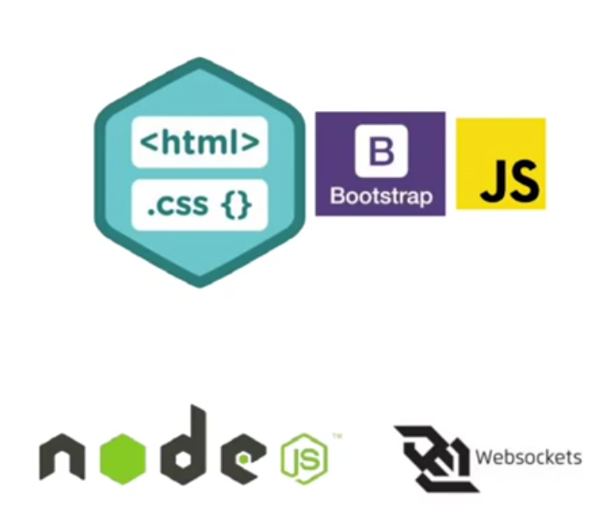
Software Specification
Website UI
HTML, CSS
JavaScript
Bootstrap
Server Side
WebRTC
NodeJs
XMAPP
PHP

Slide 6
Introduction
Query_solver unifies Peer to Peer video conferencing, online meetings, group messaging and a software-defined conference solution into one, easy-to-use platform.
Feature for student and teacher :-
Peer to peer conferencing
Inbuilt chat box

Slide 7
Working

Slide 8
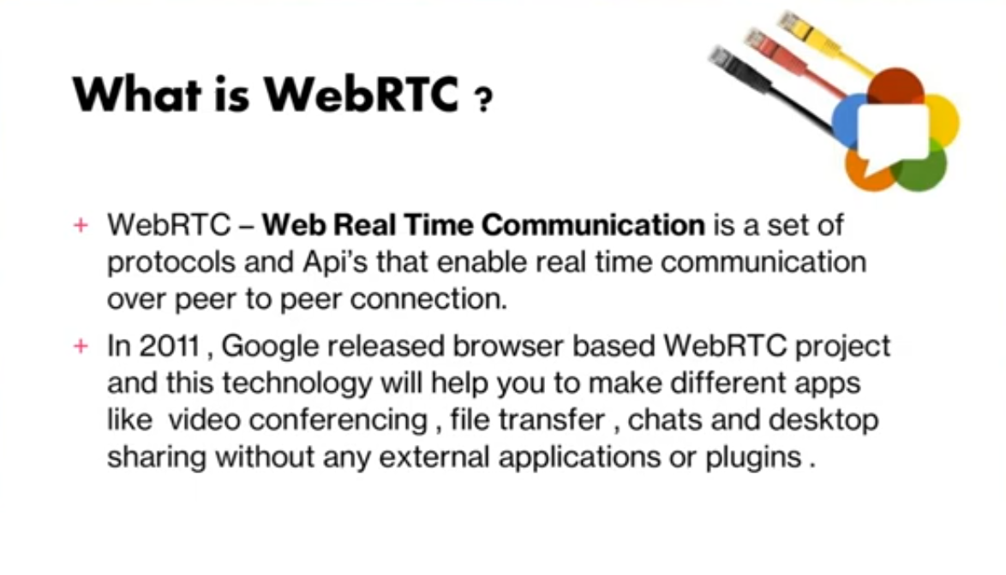

Slide 9
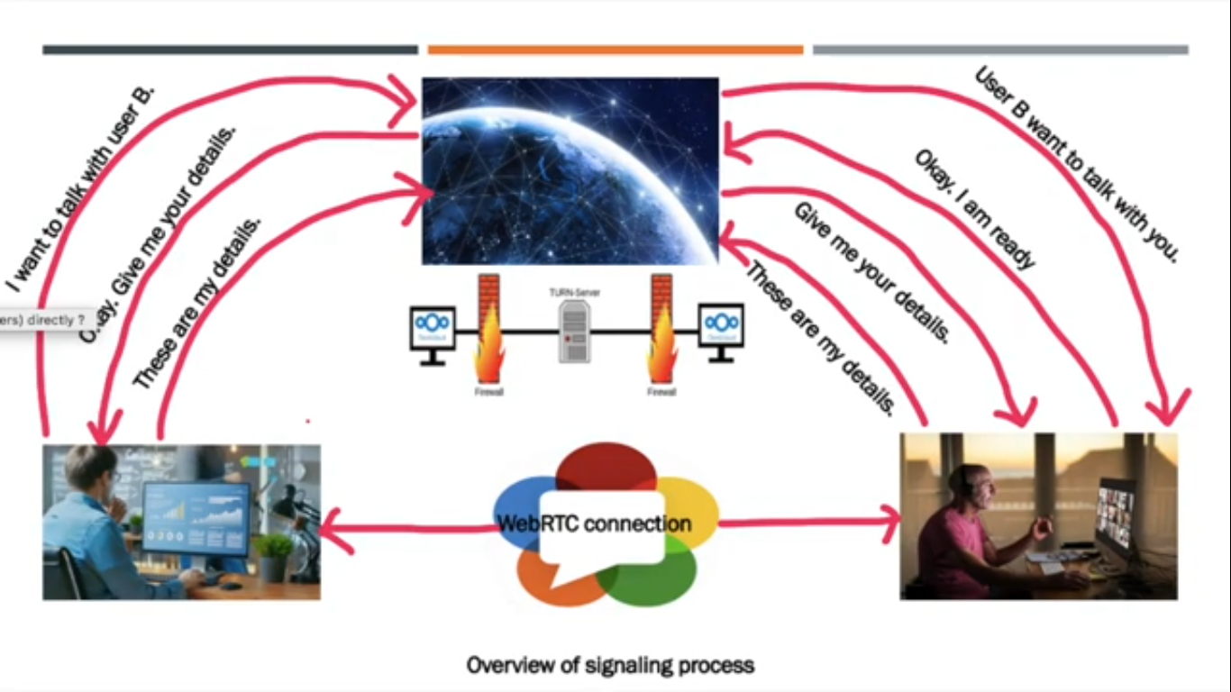

Slide 10
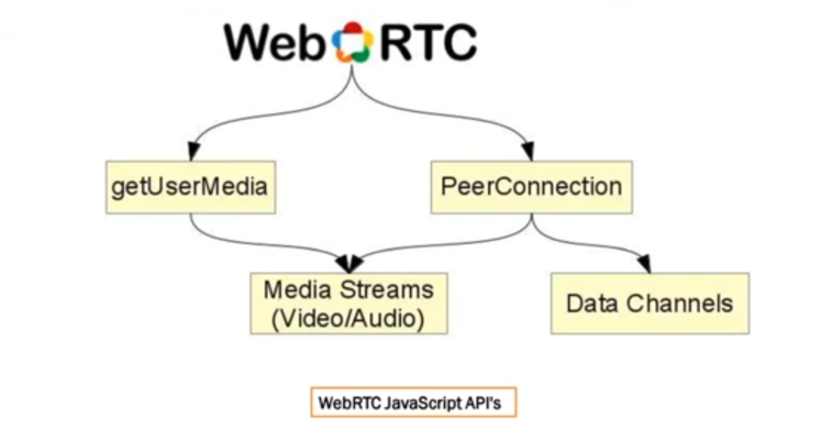

Slide 11
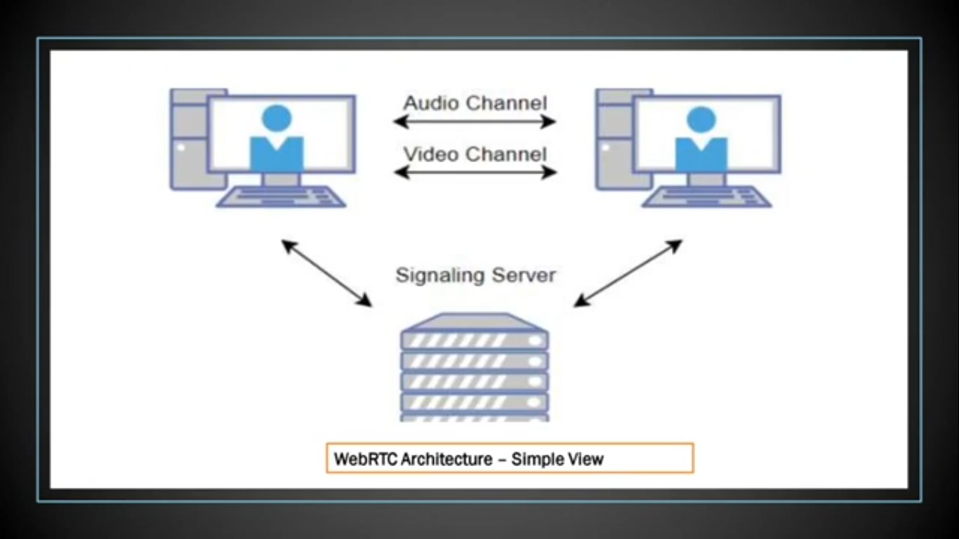

Slide 12
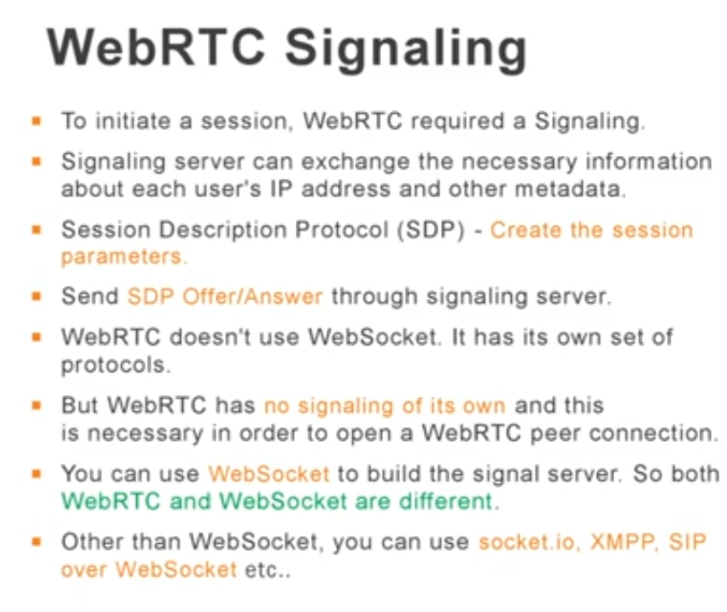

Slide 13
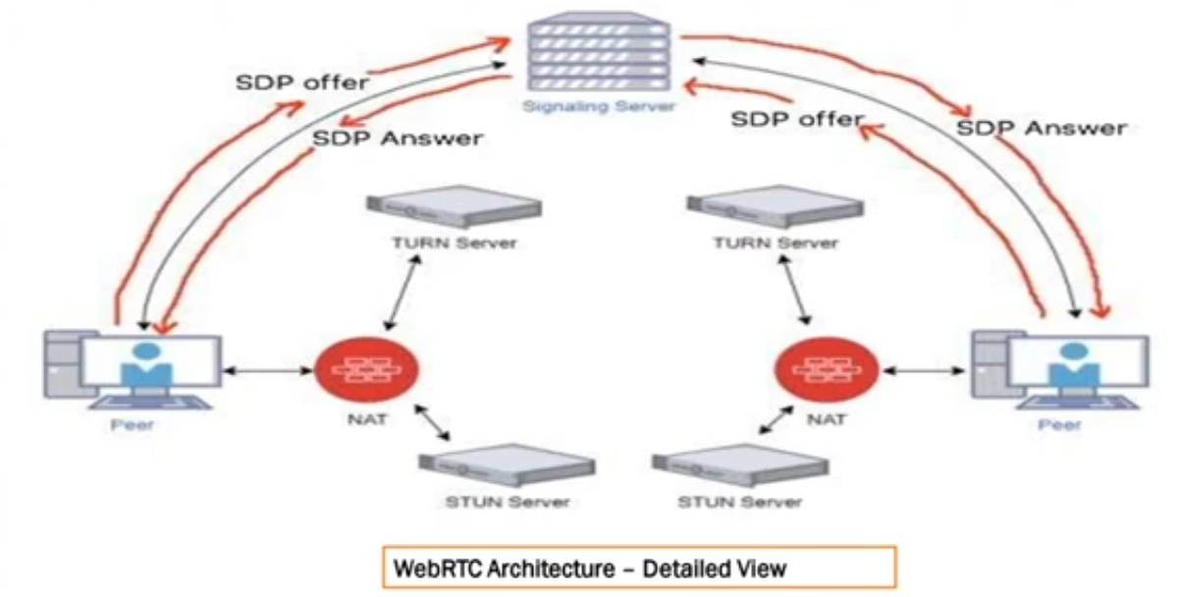

Slide 14
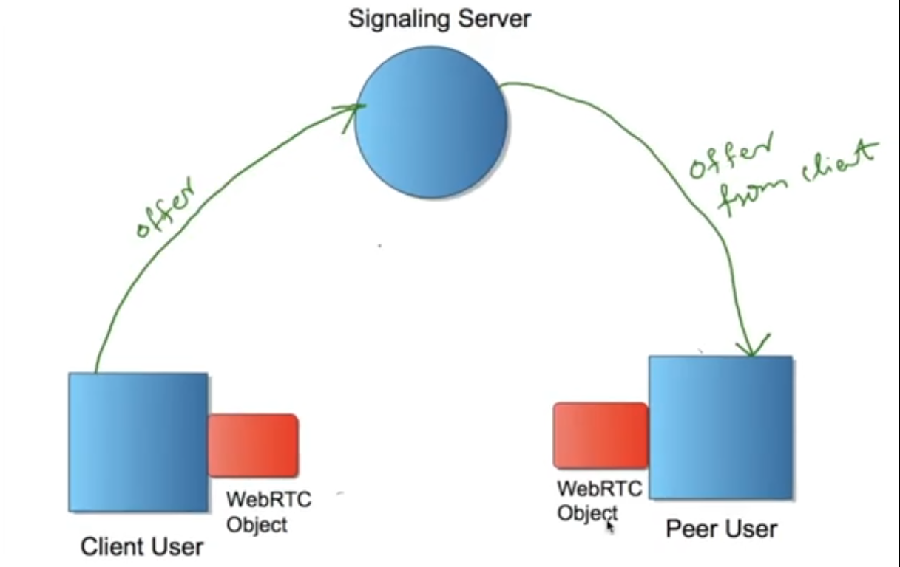

Slide 15
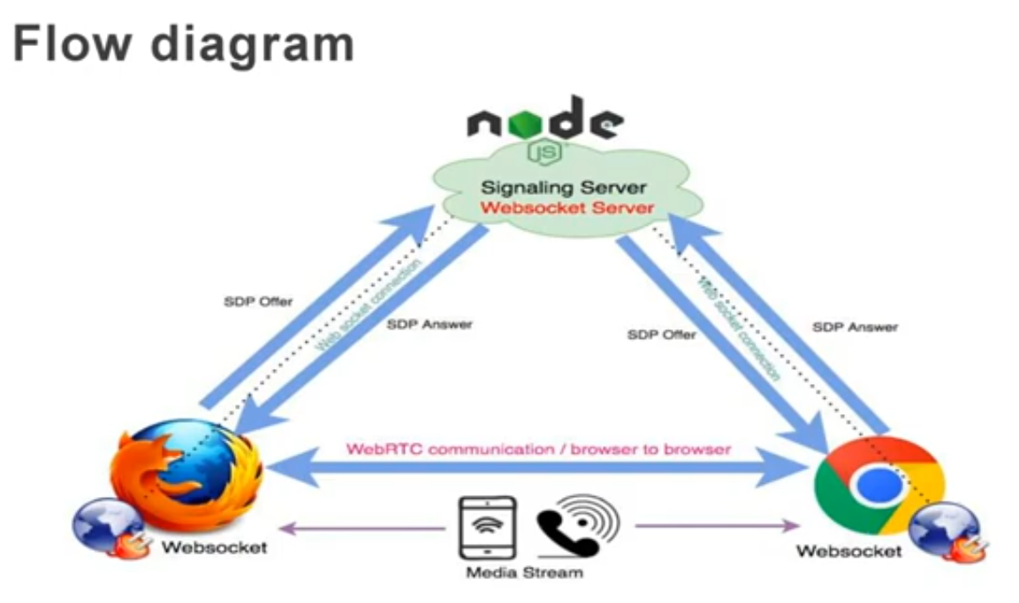

Slide 16
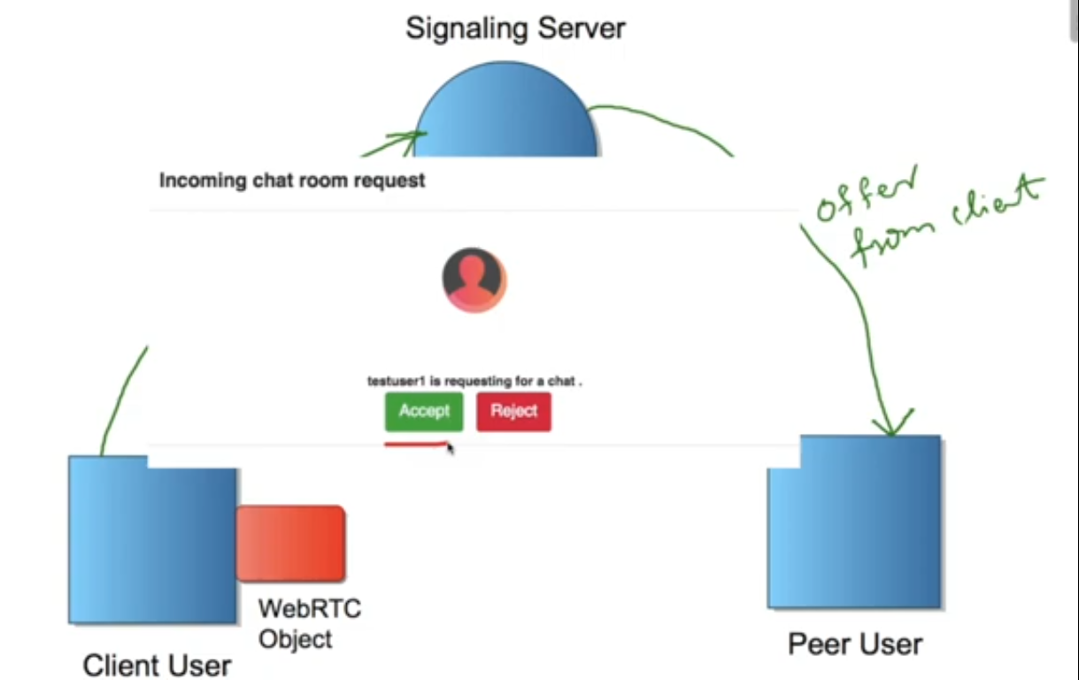

Slide 17
Use Case Diagram
Use-case diagrams describe the high-level functions and scope of a system. These diagrams also identify the interactions between the system and its actors. The use cases and actors in use-case diagrams describe what the system does and how the actors use it, but not how the system operates internally.

Slide 18
Admin
Login
Email
password
Login
Username
Password
Registration
Full name
Gender
Profession
Email
Number
Password
Re_password
Crud
Insert
View
Delete
update
Student
Teacher
Use Case Diagram

Slide 19
Name
Gender
Student
Registration
Profession
Teacher
E-mail id
Phone-no
Password
DOB

Slide 20
ER Diagram
ER Diagram stands for Entity Relationship Diagram, also known as ERD is a diagram that displays the relationship of entity sets stored in a database. In other words, ER diagrams help to explain the logical structure of databases. ER diagrams are created based on three basic concepts: entities, attributes and relationships

Slide 21
Name
Gender
Dob
Teacher
Email_id
Profession
Registration
Phone No
Student
Id
Admin
Password
Id
Login
Password
ER Diagram

Slide 22
Implementation

Slide 23
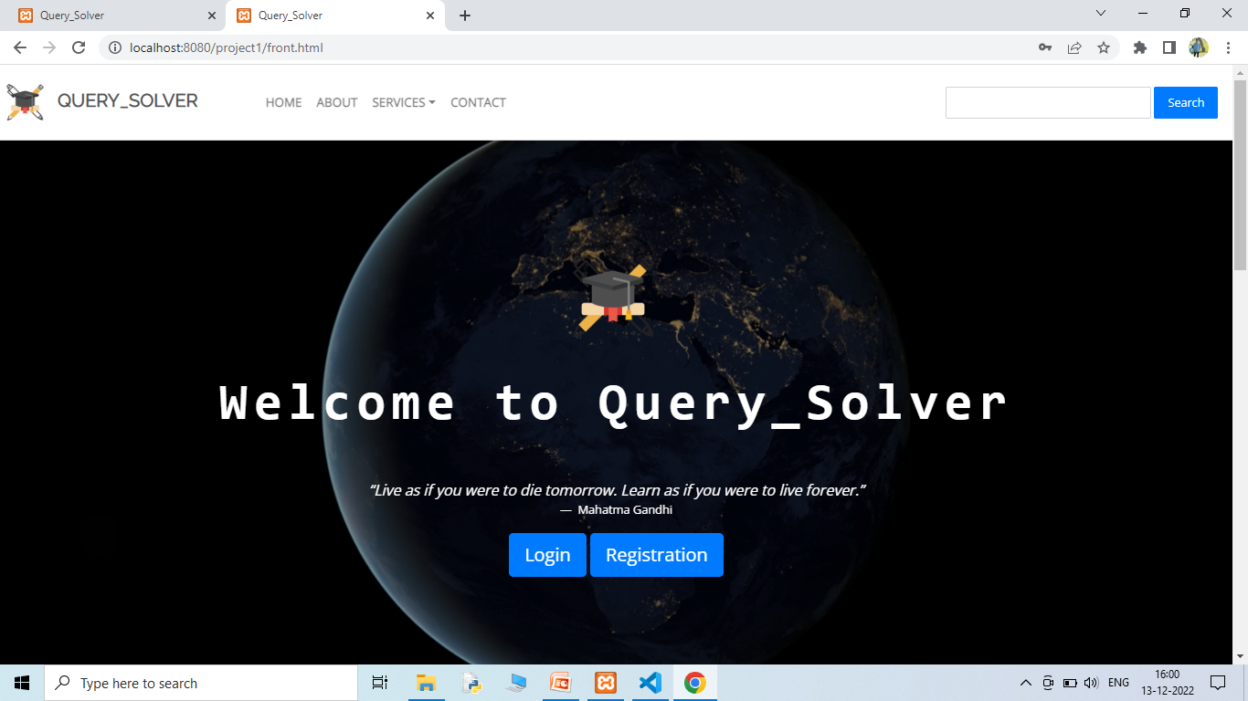
Snapshot

Slide 24
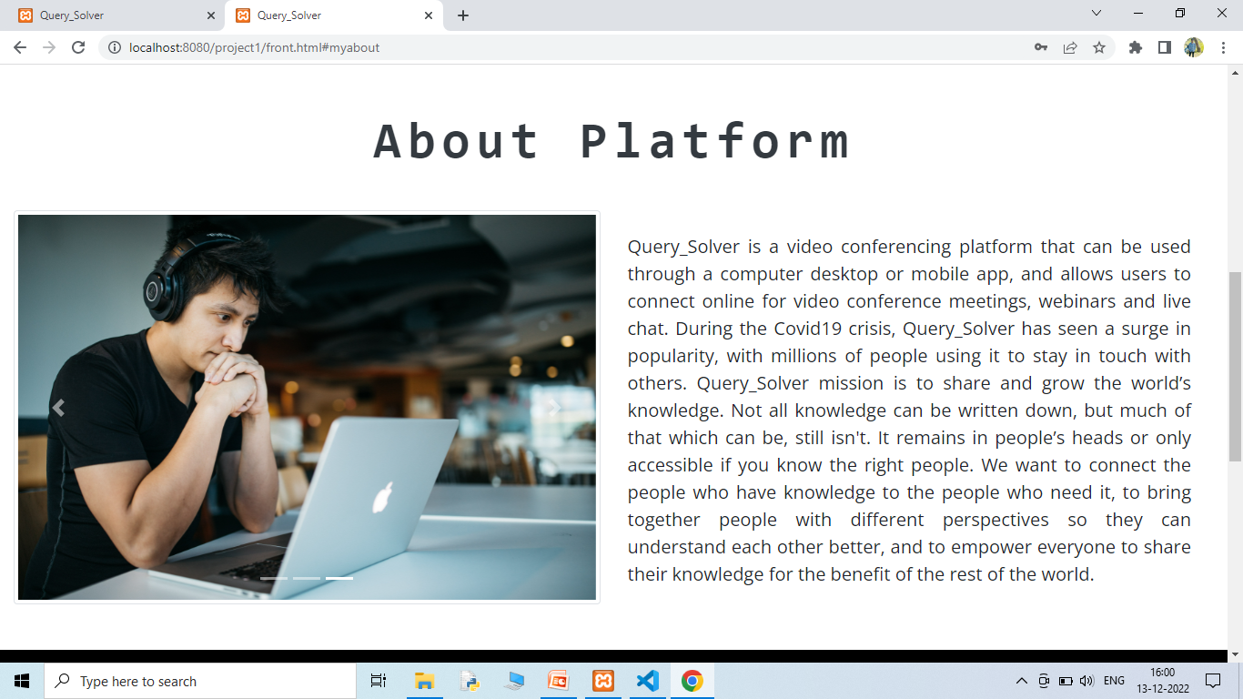

Slide 25
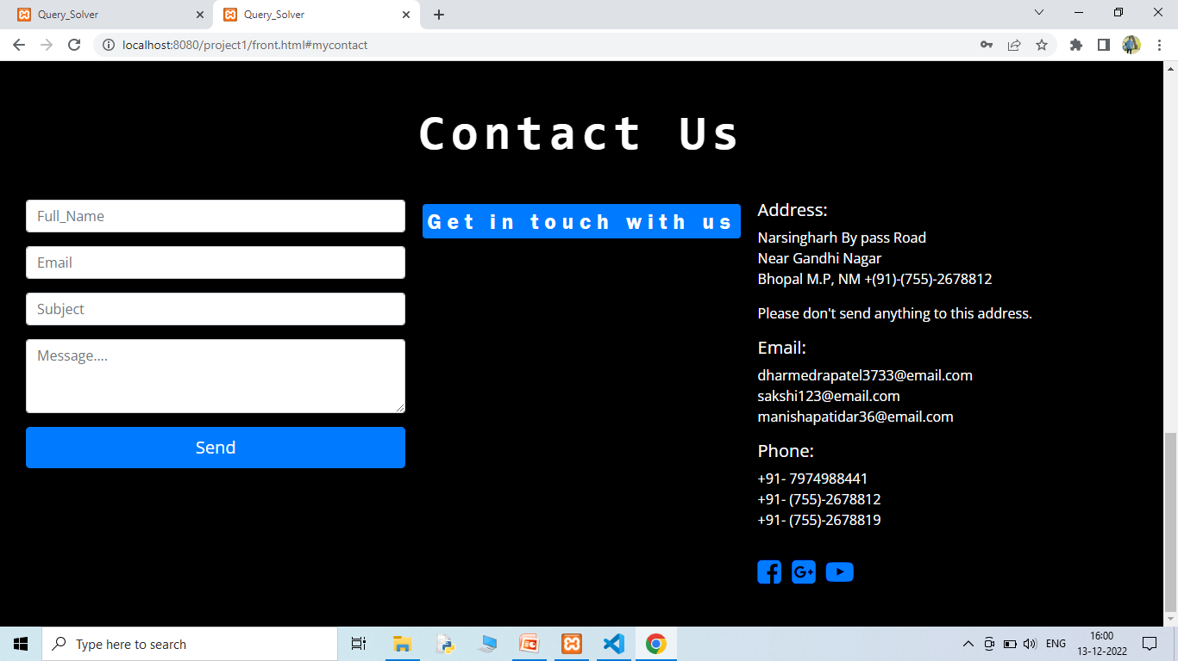

Slide 26
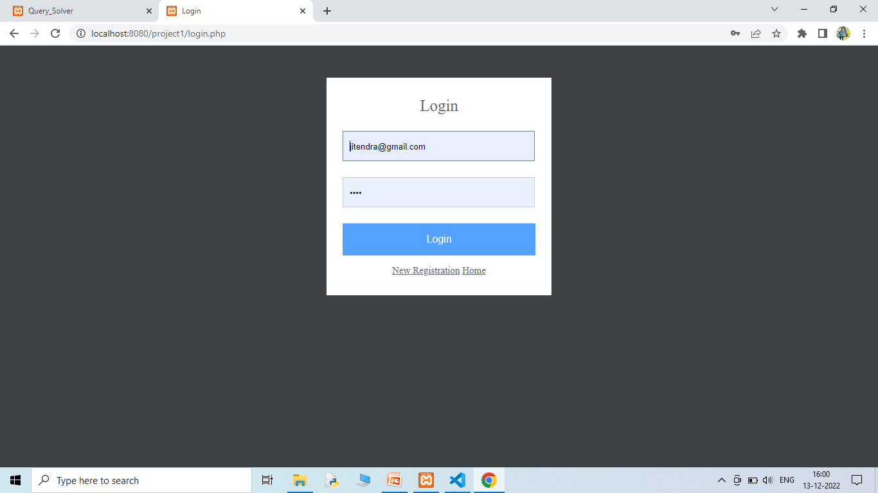
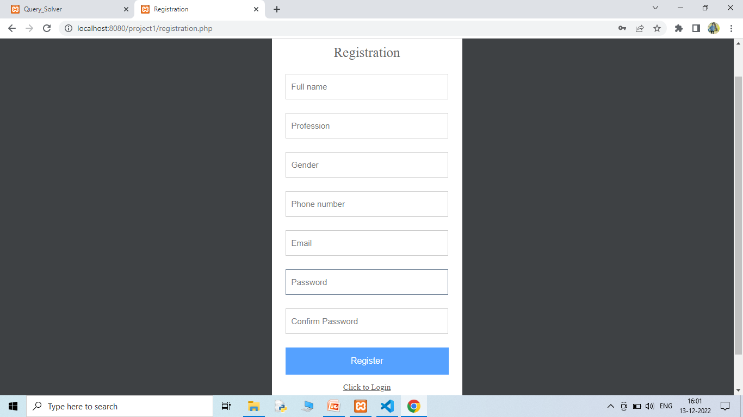

Slide 27
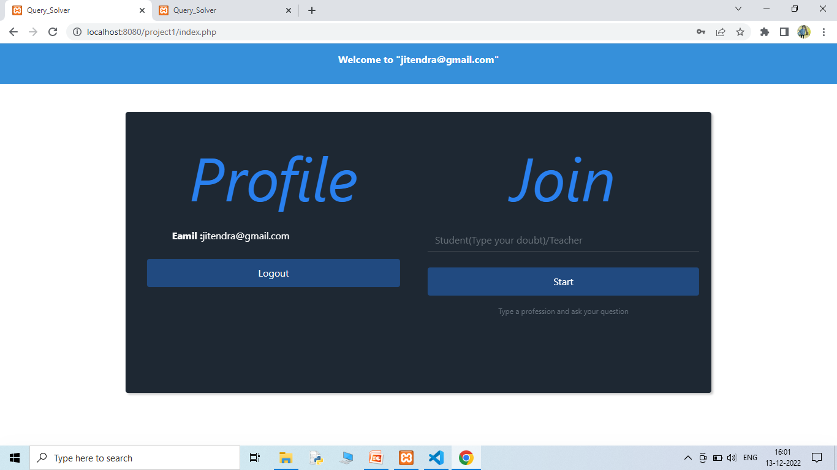

Slide 28
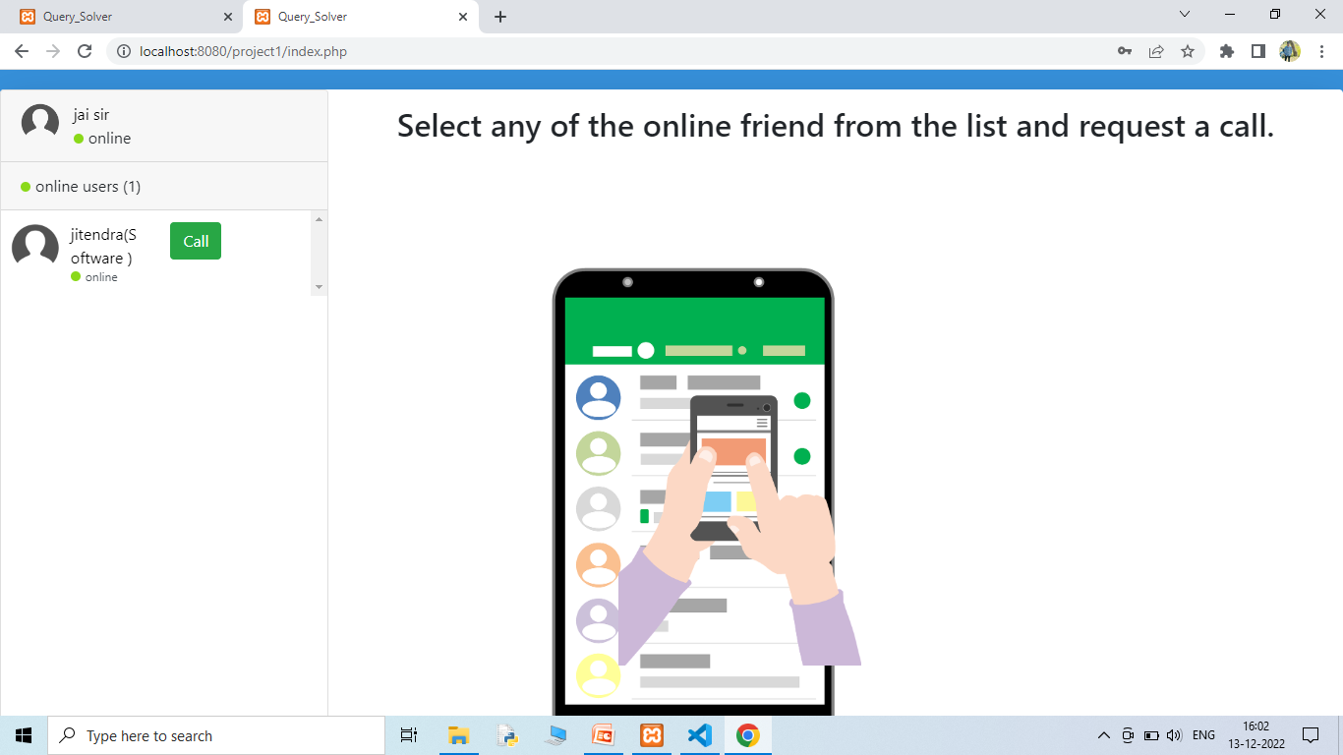

Slide 29
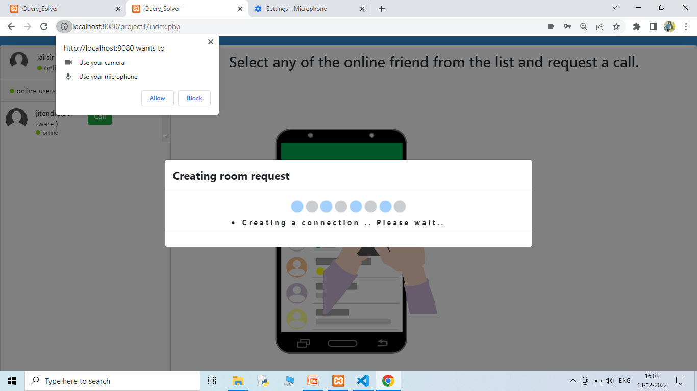

Slide 30
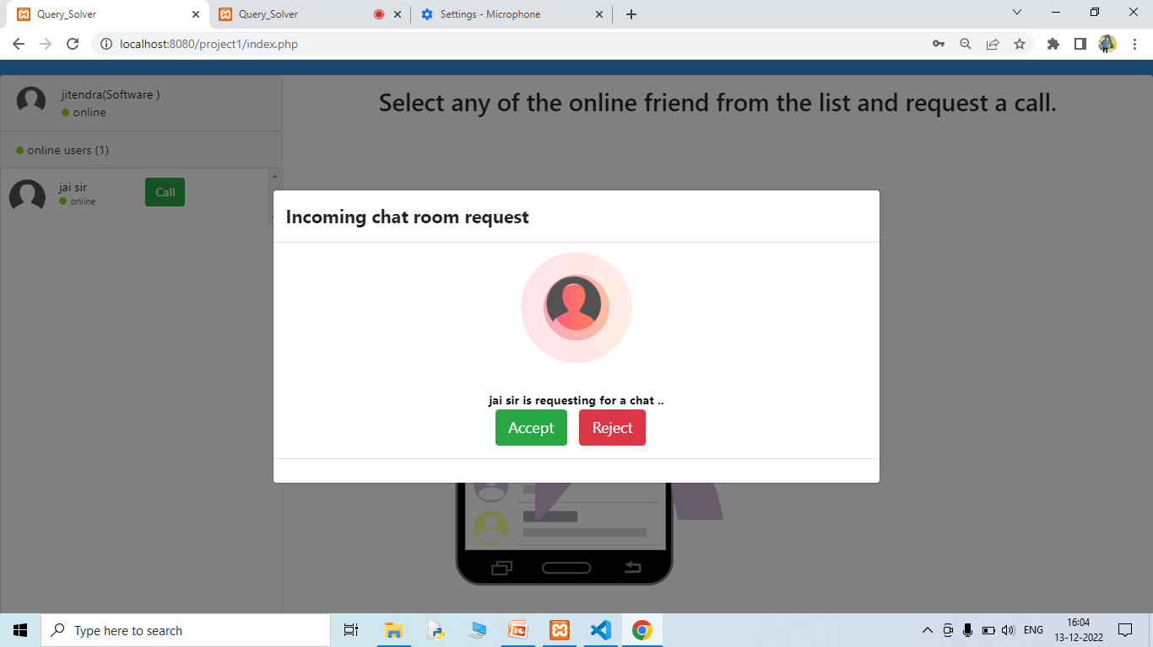

Slide 31
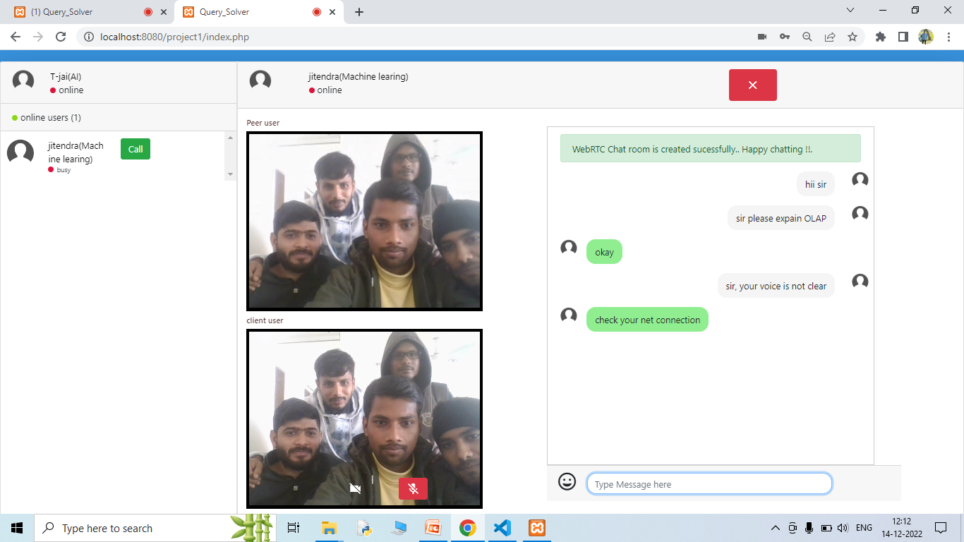

Slide 32
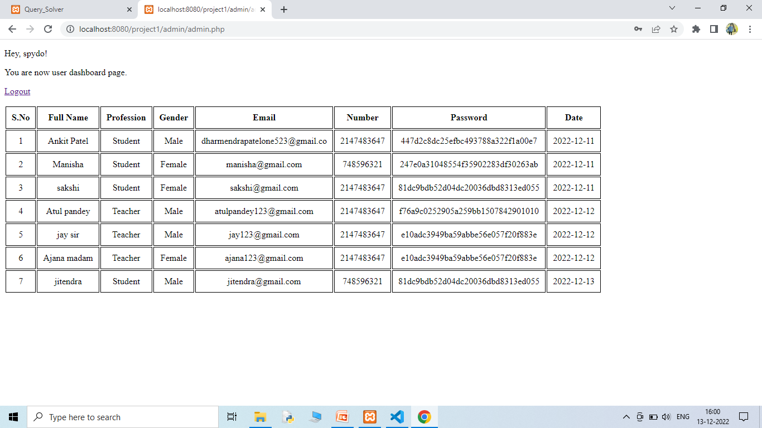

Slide 33
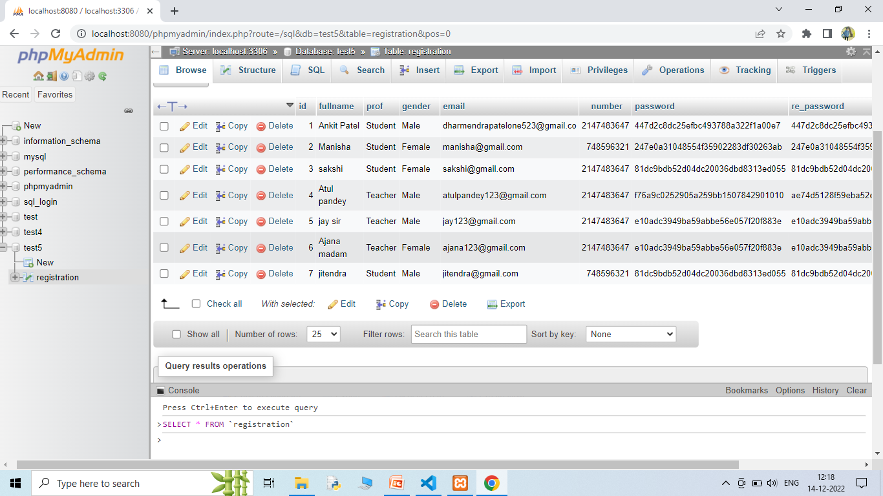

Slide 34
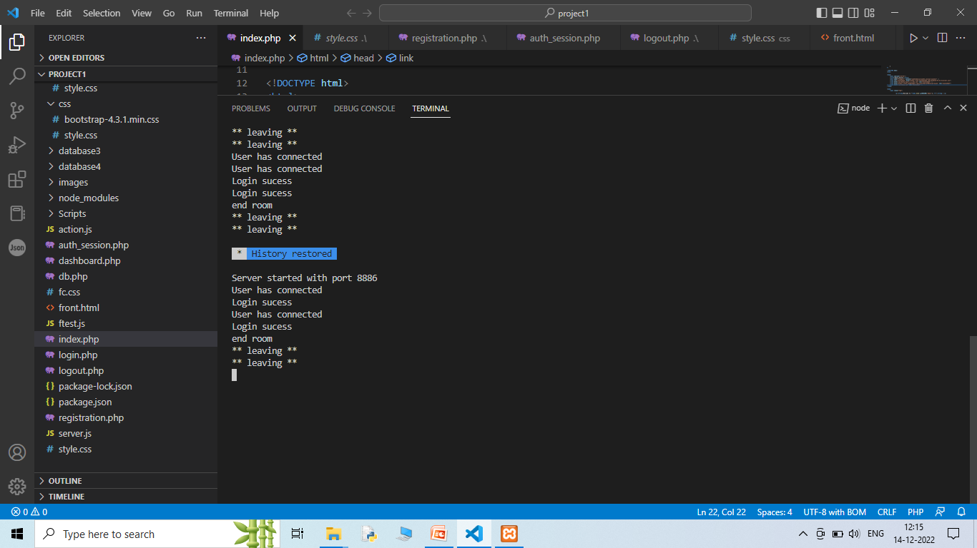

Slide 35
Prospects
Introduction a in system currency or points system which you can avail to buy study material on the platform.
You can earn these point by solving doubts of your peers
Introduce a blog post system where teacher and student can publish article on different topics explaining them in detail in a simpler way.
General UI and UX improvements.

Slide 36
Conclusion
At the start of the presentation I asked you all a question that if you could solve your doubts anywhere, anything. My could Querysolve is very much capable of doing that. Its mostly community driven so there is no corporate greed. So hop on to my platform with your doubts and stay curious.

Slide 37
Thank you
For
listening
Created by:-
Manisha Patidar,
Sakshi Gautam,
Dharmendra Patel

